Slide 1

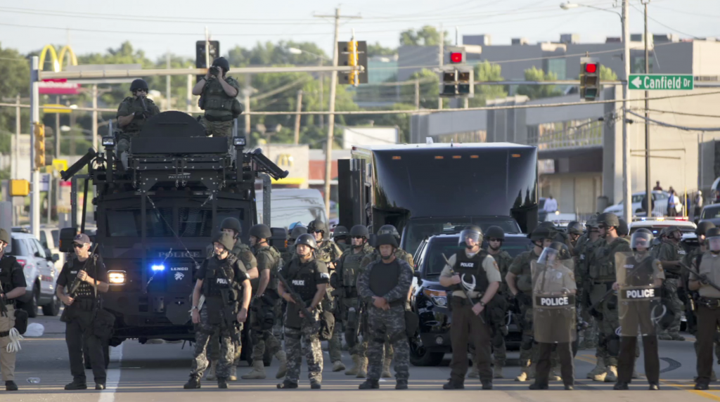
Urban Issue
Chapter 5
Police Tactics

Slide 2
My 3 questions of my chapter are:
1. The special force which first created in 1976 to deal with high-risk episoeds such as hostage resues and heavily armed grug dealers is ___________.
Answer : SWAT team
2. the gragram wchich allow the excess military fund and equipment to civilian law enforcement genvies and requore the deparment of defense to make varous items of equipment available to local law enfocement is ___________.
Answer: 1033 program
3. As we mentioned, the timeline of law enforcement in the U.S. what is the main events during 1990-1999?
Answer: millitary police cooperation boaedered

Slide 3
SWAT Team
first created in 1967 to deal with high-risk episodes such as hostage rescues and heavily armed drug dealers
SWAT team equips many military equipment in their toolkits which are problematic.
Flash-bang cause 7 unintended death and burn injuries prompting a total of $2.1 million in settlements in 2010
SWAT teams do not engage the enemy with the purpose of destroying them; they are trained to protect life
SWAT teams are used predominantly to serve search warrants, mostly in drug cases. According to an American Civil Liberties Union (ACLU) survey, 79 percent of SWAT deployments in 2011–12 involved searches — 62 percent of them for drugs.

Slide 4
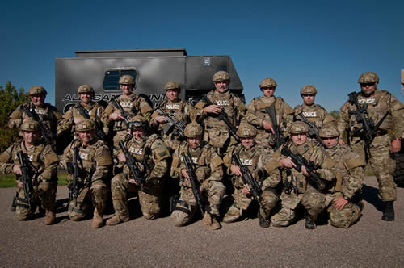
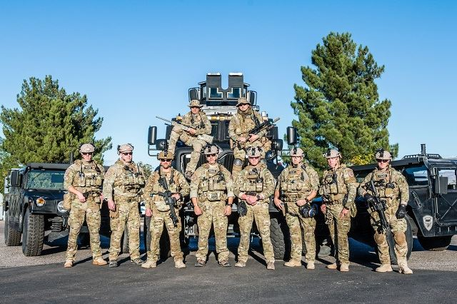
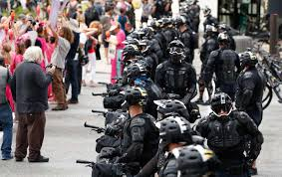
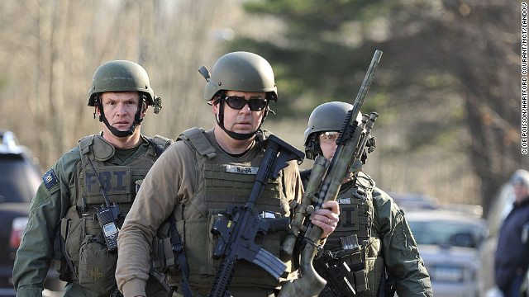
Continued
By the late 1990s, about 89 percent of departments in cities with 50,000 people or more had SWAT units, a rate that experts say holds true today.
Many people suggest that police department can use military mindset to deal with high-risk problems without using the military level weapons.

Slide 5
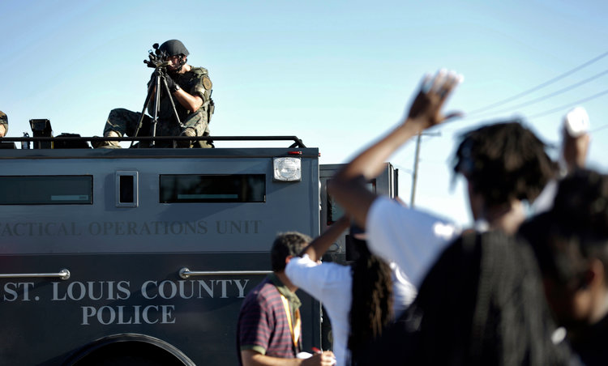
Opinions on swat teams
People are concerned that SWAT teams are being wrongly assigned to regular duties that don’t require a high-intensity approach runs through police circles. Law enforcement agent are using SWAT more and more frequently, an increase of 57,000 SWAT deployments between 1980 and 2007.
No matter when and where, police officers should not use military level and aggressive tactics which are designed to kill people rather than sav people to end up a human life.
Many cities and areas where are not bothered by drug problems do not necessarily need a SWAT team.
Even in Los Angles, the SWAT team only have about 12 callout per year.
Notes:
the “most common” task of SWAT teams — with some departments sending them to every search. That policy represented “overuse of a team created to deal with high-risk interventions,” the paper said.

Slide 6
Continued
The communities have less and less trust to law enforcement agencies after the tragedies made by SWAT teams. Many people question that whether the SWAT team received enough training to apply military level equipment.

Slide 7
1033 Program
The 1033 Program transfers excess military equipment to civilian law enforcement agencies and requires the Department of Defense to make various items of equipment available to local law enforcement.
The Law Enforcement Support Office (LESO)
Since its inception, the program has transferred more than $6.8 billion worth of property. In 2017, $504 million worth of property (based on initial acquisition cost) was transferred to law enforcement agencies.

Slide 8
Increased tensions w/ minorities
“Too many colored young people feel they are targeted by law enforcement” (Obama, 2012)
Research shows that black youths were nine times likelier — instead of 21 times likelier — to be killed by police than young white people, and the research was based on terribly uncompleted data (1/3 documents are missing)
Peter Liang (NYU officer ) undecided

Slide 9
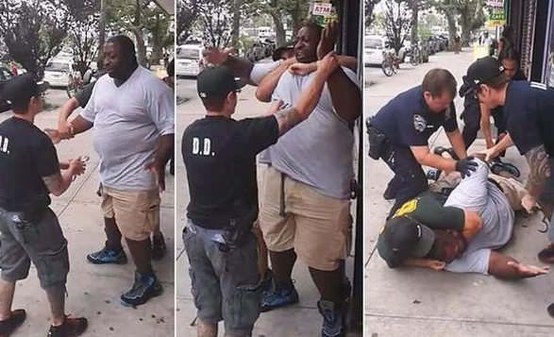
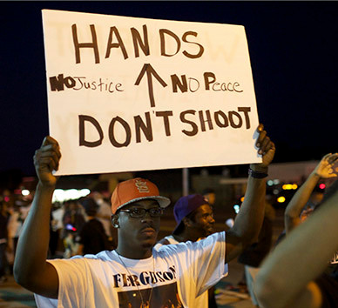
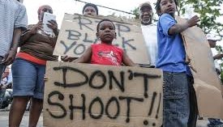
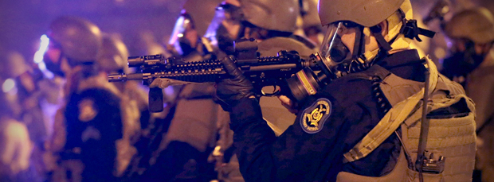
Eric Garner Choked by Police
Protest on Ferguson

Slide 10
Attempts to ensure police conduct is correct
Video taping still is the main way of collecting evidence that the law enforcement are using.
Body-worn Cameras
Both police and citizens tend to behave better when they are being recorded, and many people believe that bodycam enhance trust between communities and the police
However, there are still issues about how to use those footage and who should be able to access the footage.
Notes:
citizen complaints against officers dropped 88 percent from the previous 12 months after some officers began wearing them two years ago.

Slide 11
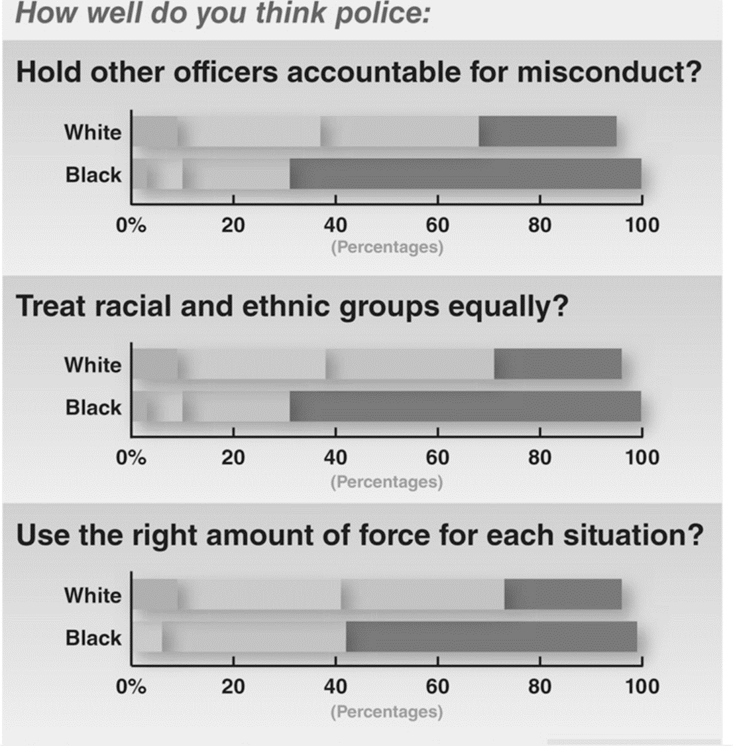
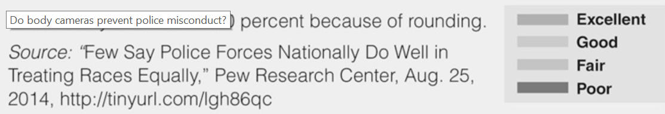

Slide 12
Timeline of how military law enforcement has grown
1957-1969 Military forces quell civil rights conflicts and urban uprisings, under exception to law barring domestic use of armed forces.
1970-1989 Drug war starts; military-law enforcement cooperation grows.
1990-1999 Military-police cooperation broadened.
2001-Present Counter-terrorism duties assigned to police departments as a result of 9/11 attacks.

Slide 13
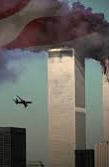
Post 9/11
After 911, SWAT team started to against narcotics and terrorism
And more and more military level weapons were able to be applied by police
Only in 2010, flash-bang caused 7 intended death, including an officer and
stop-and-frisk program(unconstitutional)

Slide 14
Current situation
Obama entered the fray in early December, announcing that he would issue an executive order designed to ensure that the 1033 program is “transparent.” The order will also be designed “to make sure that we’re not building a militarized culture inside our local law enforcement.”
The bill would block transfer of what the sponsors called high-caliber weapons, grenade launchers, armed drones, armored vehicles and grenades or other explosives. Some of this material may already be blocked for police use. Current law, for instance, restricts weapons of more than 7.62 mm caliber, such as the AK-47 assault rifle.93

Slide 15
Outlook/future/re-engineering
Many communities have relatively higher rate of crime not caused by the population of minority but the population of poverty.
The idea that police live in constant danger reflects a drug war-spawned militarization that intensified after 9/11, Stamper says. “Many departments have treated low-level drug offenders as the enemy for so long that re-engineering the culture and structure of American policing is going to take generations.”
10-point plan it said would help ease tensions between police and citizens, which included “comprehensive retraining” of all police, appointment of special prosecutors to investigate police misconduct and “widespread use” of dashboard and body cameras.107

Slide 16
References
Urban issues: Selections from CQ Researcher. (2013). Los Angeles: Sage/CQ Press

